Slide 1

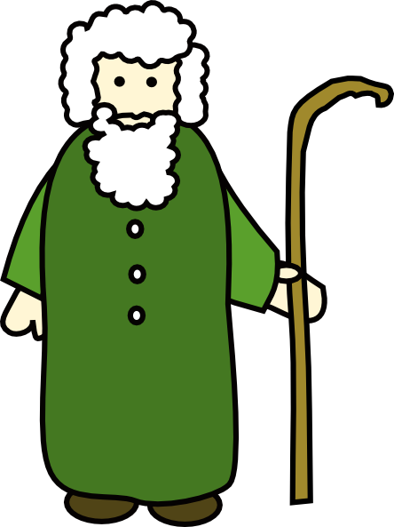
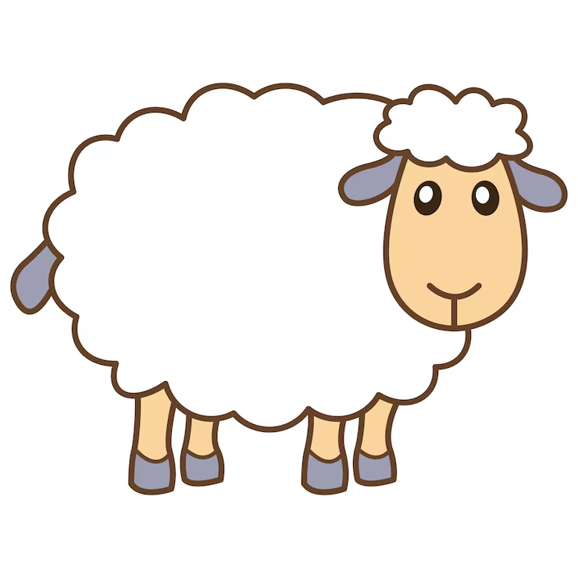
..and the sheep listen to his voice
John 10 verse 3

Slide 2
..he calls his own sheep by name and leads them out
John 10 verse 3

Slide 3
..and his sheep follow him because they know his voice
John 10 verse 4

Slide 4
Listen to his voice
Believe he knows you by name
Follow him

